Slide 1


AKSHAY MANCHEKAR
Video Game Market Analysis
Understanding Gaming Trends and Sales Data
March 2024

Slide 2
Contents
Slide Number
3
4
5
6
7
8
01
Overview
02
Platform Analysis
03
Publisher Analysis
04
Genre Analysis
05
Regional and Year Wise Analysis
06
Summary
VIDEO GAME MARKET ANALYSIS

Slide 3

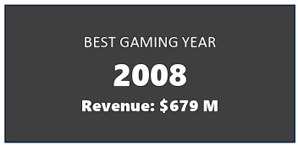

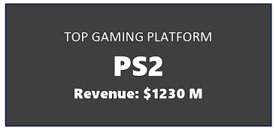
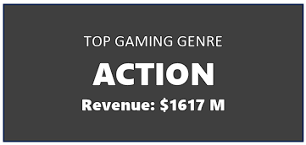
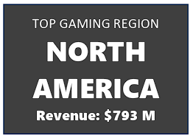

Overview of Video Game Market
WII Sports has been the top selling game since its launch till 2017.
2008 had seen a massive sales of all genres of video games.
Nintendo has the highest revenue of $1371M.
Till 2017, PS2 has the most amount of game releases & compatibility.
Action Genre of games are popular among gamers.
Every year, North America Region tops the list of amount of games sold.
The best tip for a game developer is to develop a action game, targeting the North American audience in order to garner massive profits !
VIDEO GAME MARKET ANALYSIS

Slide 4
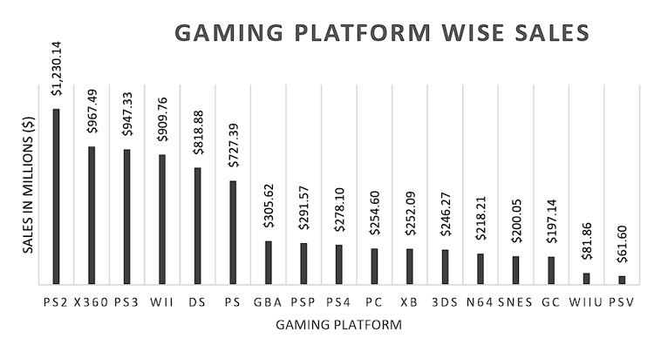
PS2 witnesses the most game releases
Key Highlights
PS2 and Xbox 360 are the market leaders as of 2017.
PS2 has games worth of $1230M.
PlayStation consoles have more exclusive games than their Xbox counterpart, thereby driving up the revenue.
WII platform, a subsidiary of Nintendo is also in the Top 4 platforms, generating a revenue of $909M.
WII platform is only compatible with Nintendo games.
GBA, 3DS, N64, SNES, GC are platforms of the past and no new games on these platforms are released as of 2017.
VIDEO GAME MARKET ANALYSIS

Slide 5
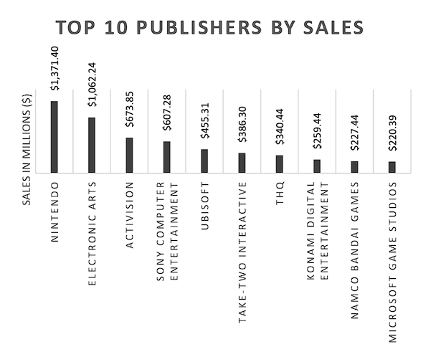
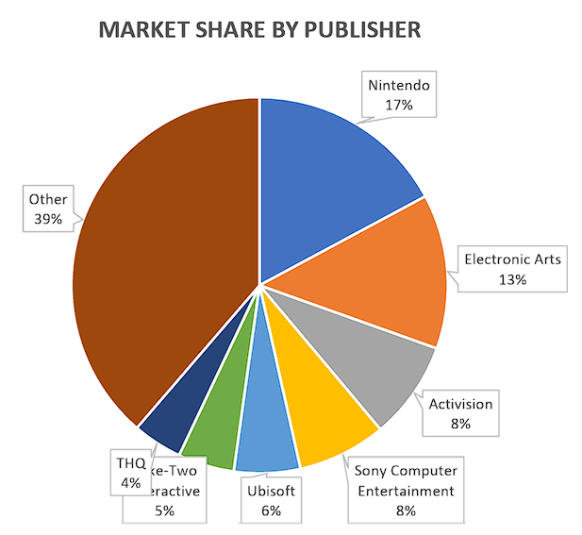
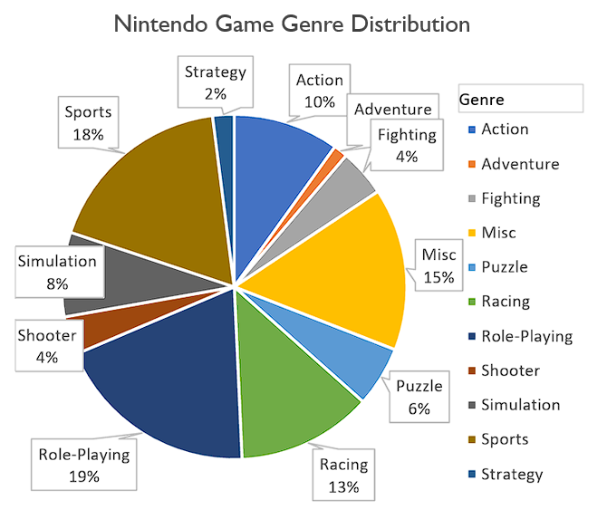
Nintendo Tops the Charts
Key Highlights
Nintendo has the highest revenue ($1371M), followed by EA, Activision and SONY.
Most of Nintendo’s revenue is generated from roleplaying, sports and racing genre of games.
The best selling game of Nintendo is WII Sports, which is also the world’s best seller.
Nintendo has a market share of approximately 17%.
VIDEO GAME MARKET ANALYSIS

Slide 6
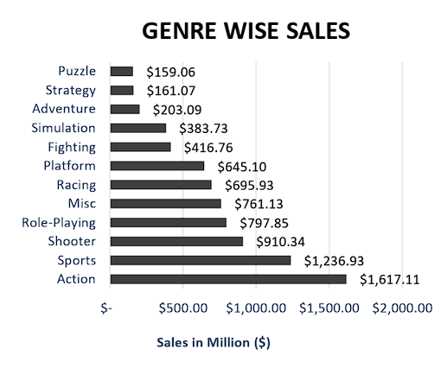
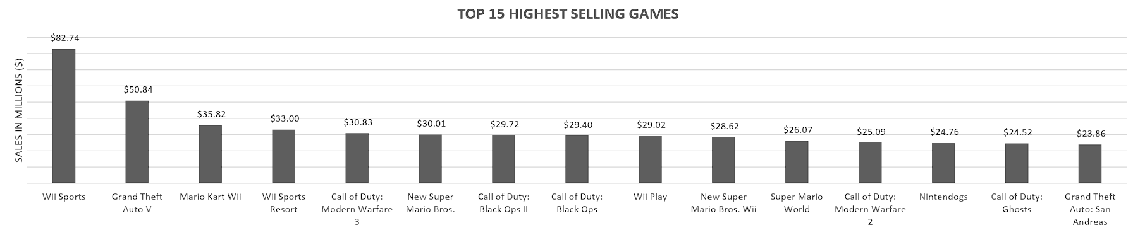
Action Genre of games are the most popular
01
Action genre of games are sold the most., followed by sports and shooter.
02
WII Sports is the best selling game, followed by GTA V and Mario Kart
03
7 out of the top 15 are action games
VIDEO GAME MARKET ANALYSIS

Slide 7
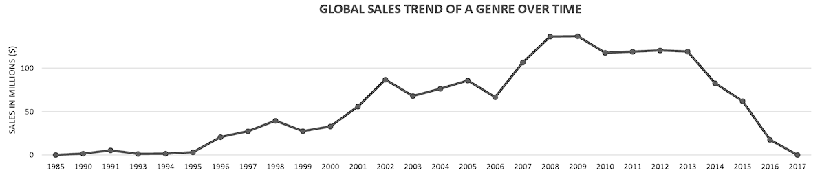
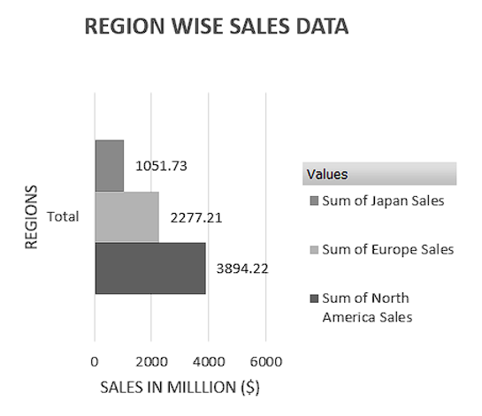
North America Tops the Sales
Key Insights
$ 3894M worth of games were sold in North America from 1985-2017.
2008 saw a boom in video game sales ($140M).
From 1996, video game sales started to increase steadily.
VIDEO GAME MARKET ANALYSIS

Slide 8
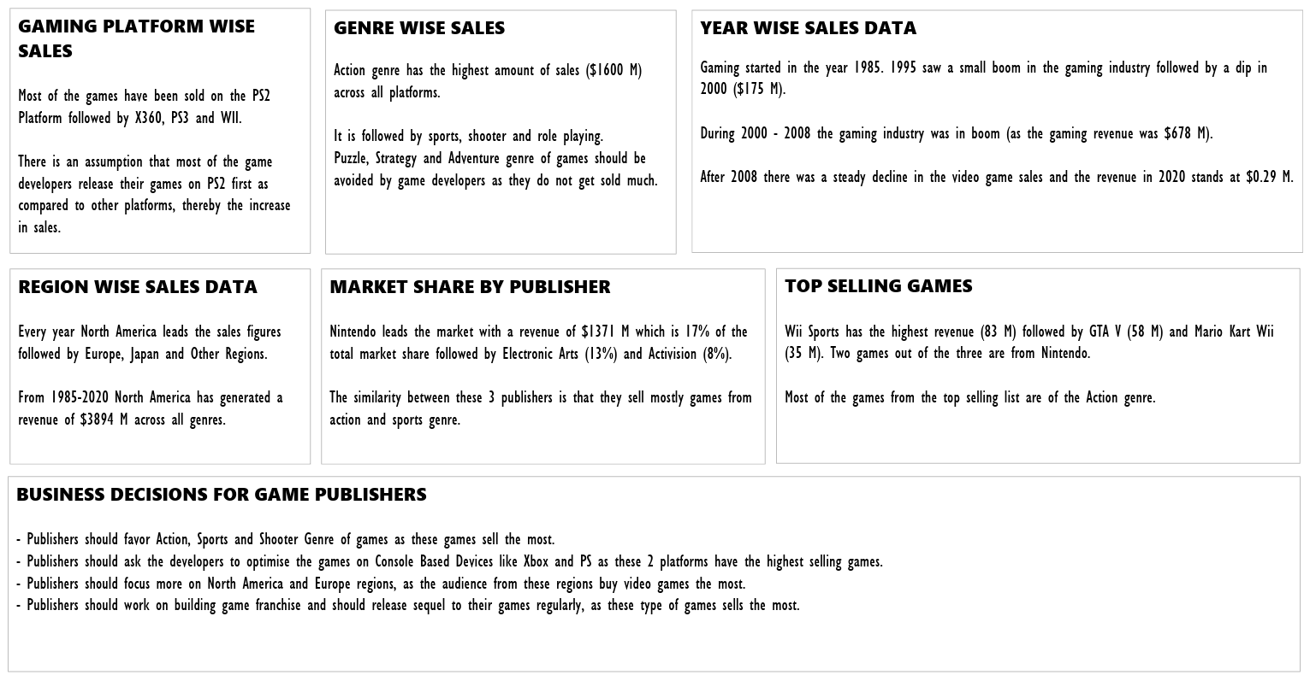
Summary
VIDEO GAME MARKET ANALYSIS

Slide 9
Thank You!

